Slide 1
A review of the evaluation of ransomware versions 1.0 to 3.0
Human Error Or Technical Failure

Slide 2
Presenters
Name | ID
Mohaimenul Azam Khan Raiaan | 011191228
Sadman Sakib | 011191097
Nur Mohammad Fahad | 011191040
Abdullah Al Mamun | 011191104

Slide 3
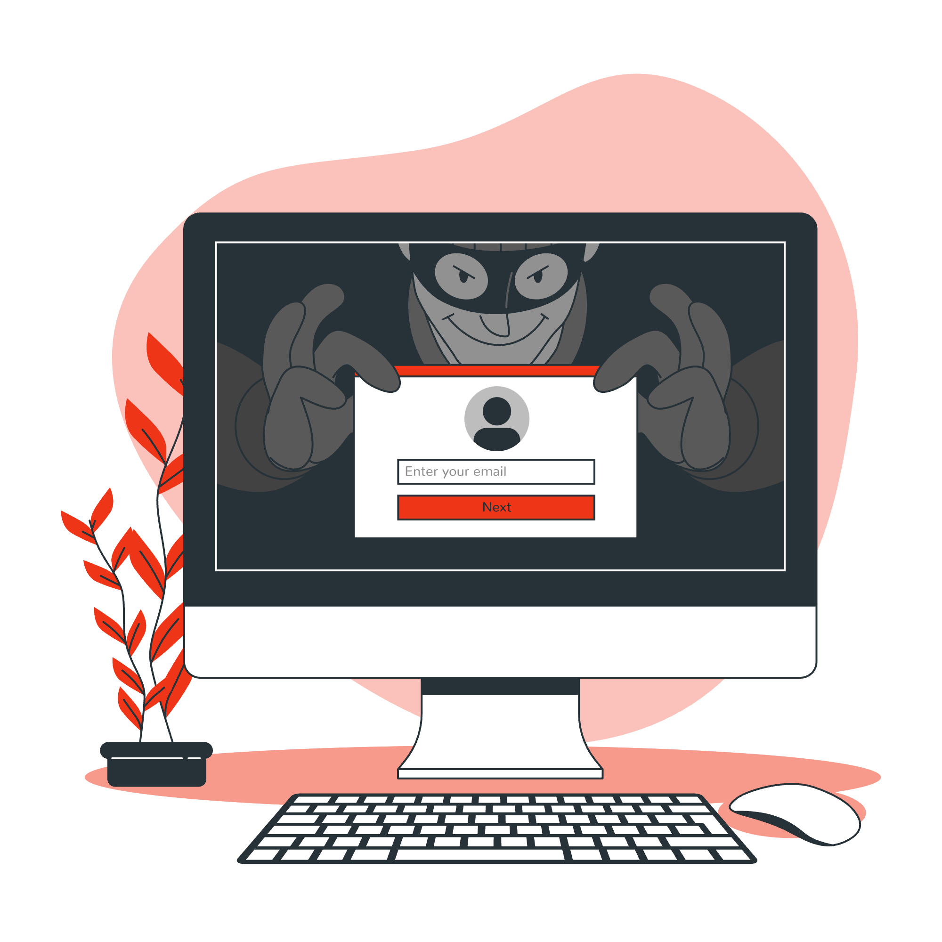
What is Ransomware?
Type of malware that encrypts a victim's data or computer system and demands a ransom payment in exchange for the decryption key.

Slide 4

Biggest ransomware attacks in recent years
WannaCry: In 2017, WannaCry infected over 200,000 computers in 150 countries, causing billions of dollars in damages.
NotPetya: In 2017, NotPetya caused over $10 billion in damages by infecting thousands of computers worldwide, primarily in Ukraine.
Ryuk: Since 2018, Ryuk has been used in numerous attacks, targeting organizations in the United States, Europe, and Asia, and causing millions of dollars in damages.
REvil/Sodinokibi: REvil/Sodinokibi is responsible for a number of high-profile attacks, including the 2021 attack on Kaseya, which affected over 1,000 businesses.
Conti: Conti has been responsible for several attacks in 2021, including the attack on Ireland's national health service.

Slide 5
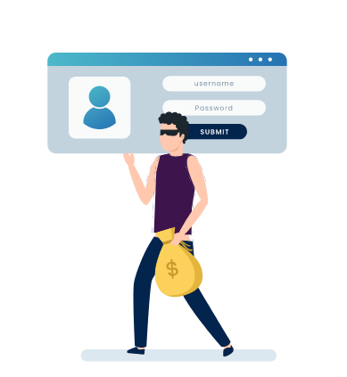
Different versions of Ransomware
Ransomware 1.0:
Introduced in the late 1980s and early 1990s and mainly spread via floppy disks.
Encrypt a user's files and demand money in return for the key to unlock them.
Ransomware 2.0:
First appeared in the middle of the 2000s.
More advanced methods, such as social engineering, to trick victims into visiting malicious websites or downloading dangerous attachments.
More robust encryption methods and cryptocurrencies have made anonymous payments easier for criminals.
Ransomware 3.0:
Most recent version of ransomware and is more sophisticated and dangerous than prior versions.
Use high-tech resources like Artificial Intelligence and machine learning
mploys "double extortion" tactics, in which hackers not only encrypt the documents of a victim but also take crucial data and threaten to publish it publicly if the ransom amount is not paid.

Slide 6
Literature Review
Title | Author | Findings
Information security climate and the assessment of information security risk among healthcare employees, | Kessler et al. | Majority of breaches are the result of employee carelessness and/or noncompliance with information security policies and procedures.
The human dimension as the core factor in dealing with cyberattacks in higher education | Othman et al. | People have a crucial role in both preventing and causing cyberattacks. A pervasive lack of awareness and carelessness in maintaining passwords contributes to the vulnerability of higher education institutions to cyberattacks.
State of cyber security and the factors governing its protection in malaysia, | Muniandy et al. | Cybersecurity protection is determined primarily by technological, organizational, and human factors. The human element must be managed with care if the technological and organizational components are to be effective.
Cyber security: Economic strategies and public policy alternatives. | Gallaher et al. | Technological advancements may play a significant role in the motivation behind ransomware. Both attackers and security administrators can utilize certain security tools for contradictory purposes.
Are employees part of the ransomware problem? | Fimin et al. | Employees’ reckless or irresponsible actions contribute to the ransomware issue. Majority of organizations consider that their own employees pose the greatest risk of system disruption and security breaches.

Slide 7
Survey
Demographic
Description | Percentage
Age | 1. range (25-34) 28.6%, 2. range (18-24 26.9%, 3.range (35 above) 26.2%, 4. range (Under 18) 18.3%,
Occupation | 1. Student 11%, 2. Medical Doctor 5.5%, 3. Govt. Employee 3.7%, 4. Accountant 3.0% 5. Others 76.8%
Education Level | 1. Graduation 40.9% 2. Post Graduation 31.9% 3. HSC 12.3%. 4. Diploma 11.1%, 5. Others 3.8%
Gender | Male 59.1% , Female 40.9%
Organization | 1. Healthcare 23.3%, 2. Education 16.6%, 3. IT 10.9%, 4. Finance 3.7%. 5.Others 45.5%

Slide 8
Main topic of the question | Majority | Minority | Other
Do you use strong and unique passwords? | Never (55%) | Always(32%) | Sometimes (13%)
Do you always use two-factor authentication? | No (72%) | Yes(21%) | Some accounts (7%)
Have you ever fallen for a phishing scam? | No (52%) | Yes (45%) | Other (3%)
How often update your computer's operating system? | Rarely (74%) | Monthly (20%) | Weekly (6%)
Download software from an untrusted source? | Yes (66%) | No (34%)
Use antivirus or anti-malware software? | Yes (59%) | No (24%) | Some device(17%)
Shared sensitive information using an unsecured network? | Yes (53%) | No (17%) | maybe (30%)
Click on unknown links or suspicious sources? | Frequently (57%) | Never (20%) | Occasionally (23%)
Use the same password for multiple accounts? | Frequently (46%) | Never (15%) | Occasionally (39%)
Do you back-up important data on your device? | Rarely (43%) | Weekly (21%) | Monthly (36%)
Does your organization regularly update security policies? | Not enforced (49%) | No (14%) | Enforced regularly (37%)
Use encryption to protect sensitive data? | Yes (72%) | No (8%) | Sometimes (20%

Slide 9
Methodology
The data was collected through a survey of various organizations, and a questionnaire was designed to collect information from employees about their cybersecurity practices and personal experiences with ransomware attacks.
Participants were selected at random to ensure a representative sample, and the data was analyzed statistically using descriptive and inferential statistics to identify the primary causes of ransomware expansion.
The survey results revealed that there is a critical need for individuals and organizations to enhance their security routines and practices, particularly with regard to software upgrades, strong passwords, and security awareness training.
The majority of respondents did not use strong and unique passwords, rarely updated their operating system and antivirus programs, and often downloaded software from untrusted sources.
However, a significant number of participants always used two-factor authentication, frequently backed up important data, and never fell for phishing scams. Many organizations updated their security policies regularly and conducted security awareness training for employees, but a significant percentage did not enforce security policies.

Slide 10
Findings
Human negligence is the primary cause of ransomware attacks, according to the survey conducted in the study.
Technological advancements have led to the creation of more sophisticated and complicated ransomware strains, making it harder for traditional security measures to keep up.
Mobile devices and remote work have increased the risk of ransomware attacks, as they may be less protected from cyber threats than office counterparts.
Education and training programs can mitigate the risk of human error and decrease the likelihood of successful ransomware attacks.
Thorough security procedures that deal with both technical and human weaknesses are crucial to better protect organizations and their employees from ransomware attacks.

Slide 11
Conclusions
Ransomware attacks are a major concern in today's digital society.
Cybercriminals are constantly developing new techniques to exploit vulnerabilities.
This study aims to identify the main causes of ransomware attacks and evaluate current prevention measures.
The study focuses on the correlation between technology vulnerabilities and human behavior.
The study provides recommendations for individuals and businesses to enhance their defenses against ransomware attacks.

Slide 12
Thanks!

